Slide 1
SUDOKU SOLVER
U19CS011 RAJ JIKADRA
U19CS012 BHAGYA RANA
U19CS049 DEV JARIWALA
U19CS080 MUKTESHARYAN UPPALA

Slide 2

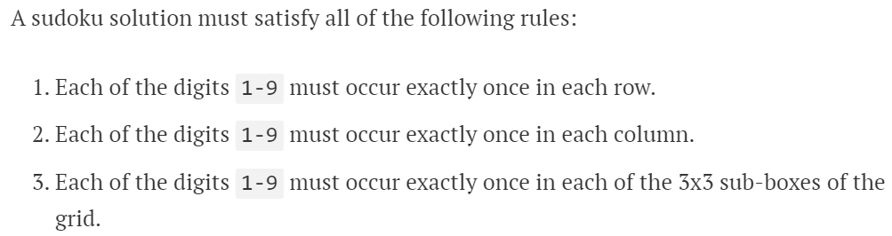
SUDOKU SOLVER

Slide 3
WHAT IS SUDOKU?
Sudoku is a logic-based, combinatorial number placement puzzle game where the objective is to fill a square grid of size ’n’ with numbers between 1 to ’n’.
The numbers must be placed so that :
each column,
each row, and
each of the sub-grids (if any) contains all of the numbers from 1 to ‘n’.

Slide 4
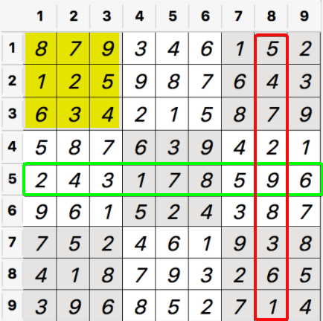
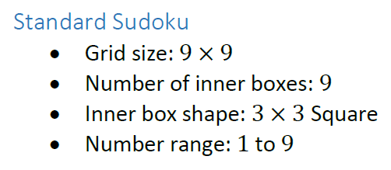
EXAMPLE:

Slide 5
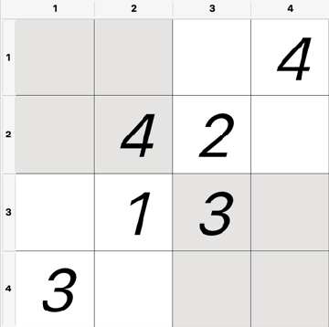
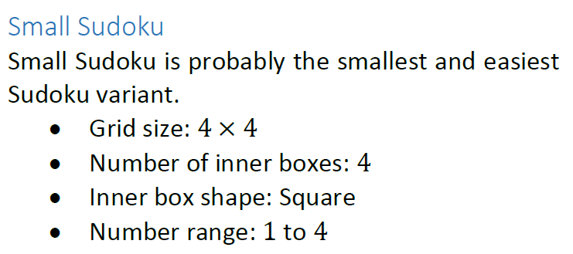
4x4 SUDOKU?

Slide 6
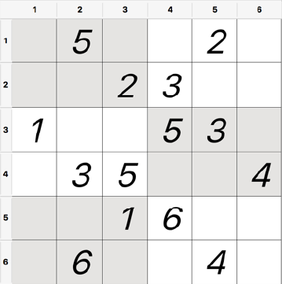
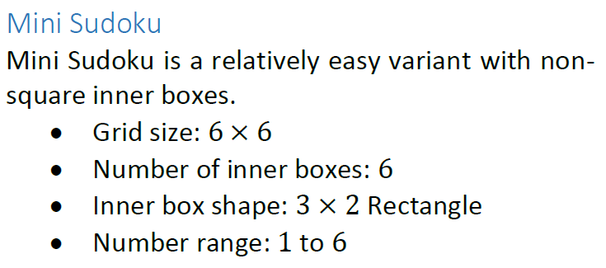
6x6 SUDOKU?

Slide 7
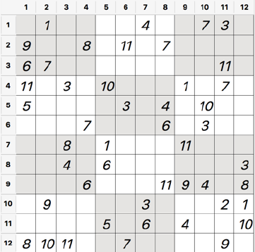
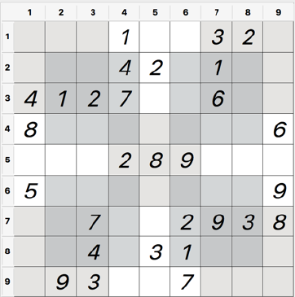
9x9 & 12x12 [Not Always Square Number]?

Slide 8
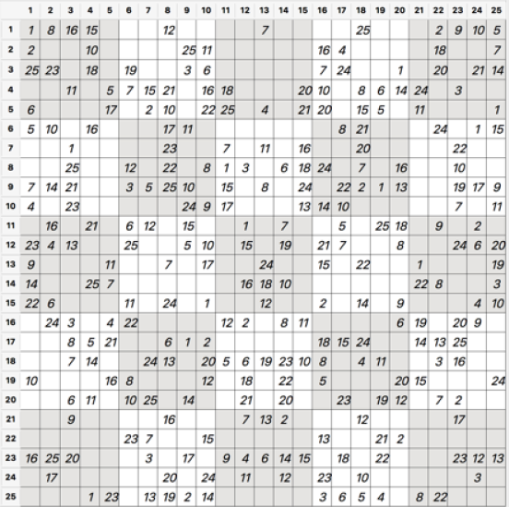
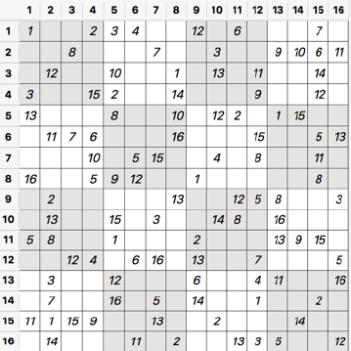
16x16 & 25x25?

Slide 9
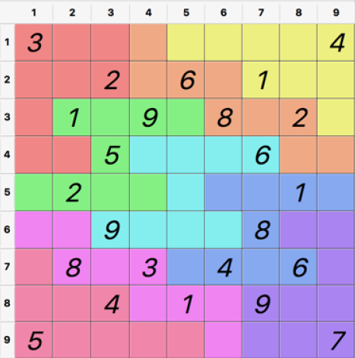
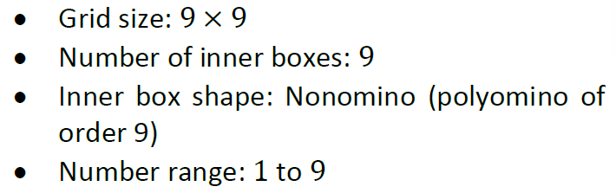
JIGSAW SUDOKU?
The only difference to the standard Sudoku is the shape of the inner blocks

Slide 10
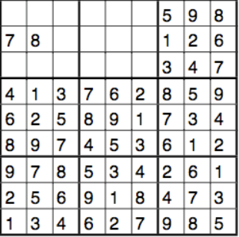
ARE SUDOKU ALWAYS SOLVABLE?
Answer is : YES
Unless it doesn’t Violates the 3 Standard Rules of Sudoku [Row,Column,Grid]
Any Sudoku can have:
Unique Solution
Multiple Solution [Where we need to Guess]

Slide 11
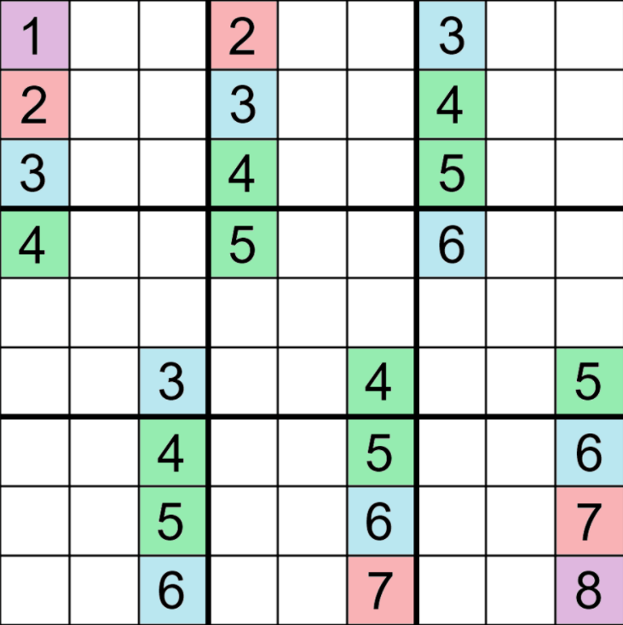
HOW MANY HINTS NEEDED TO SOLVE SUDOKU?
There are 26 types of symmetry, but they can only be found in about 0.005% of all filled grids.
A puzzle with a unique solution must have at least 17 clues, and there is a solvable puzzle with at most 21 clues for every solved grid.

Slide 12
WHAT ARE METHODS OF SOLVING SUDOKU?
Sudoku puzzles are NP-complete problems and as such, their solution can be found by performing an exhaustive search.
Pen and Paper Algorithm
Brute Force Search/BackTracking/Depth For Search
Crook’s Algorithm

Slide 13
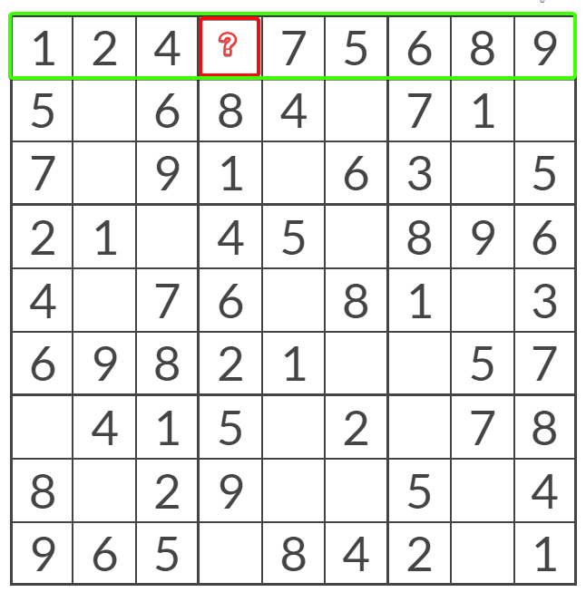
PEN AND PAPER ALGORITHM
Unique missing candidate
Check if a Row/Column/Grid has only 1 Number Left

Slide 14
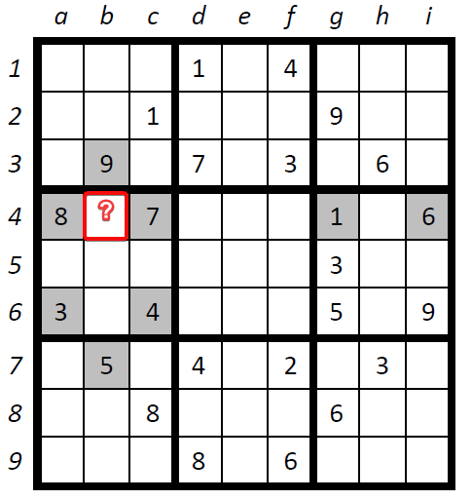
PEN AND PAPER ALGORITHM
(2) Naked Single
Find a square that takes a single value, considering squares in the same row, column and box.

Slide 15
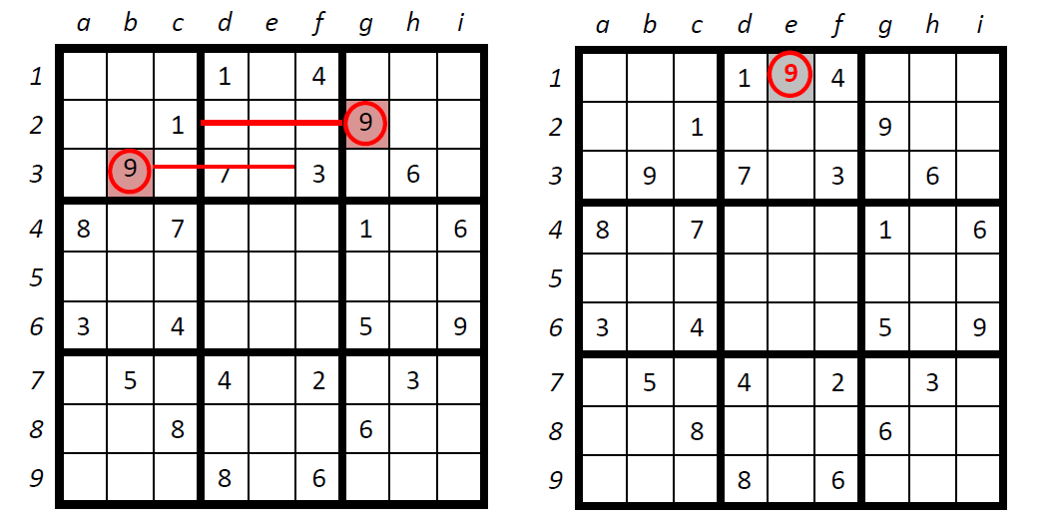
PEN AND PAPER ALGORITHM
(3) Hidden Single

Slide 16

FAKE OR NOT FAKE - QUESTION
“The difficulty of a sudoku puzzle is related to the number of clues it has”
Greater the Number of Clues, Lesser the Difficulty !
FAKE OR NOT FAKE?

Slide 17
FAKE OR NOT FAKE ANSWER
Answer is Fake! What?
The level of difficulty is defined by the number of steps required to solve it, as well as the complexity of the techniques needed for a person/an algorithm to solve the puzzle.
A bottleneck is a situation in which there is only a single move which will make it possible to continue solving. Thus, the more bottlenecks in a puzzle, the harder it becomes, even if the required solving techniques are easy, as many squares have to be visited in order to find that specific move.

Slide 18
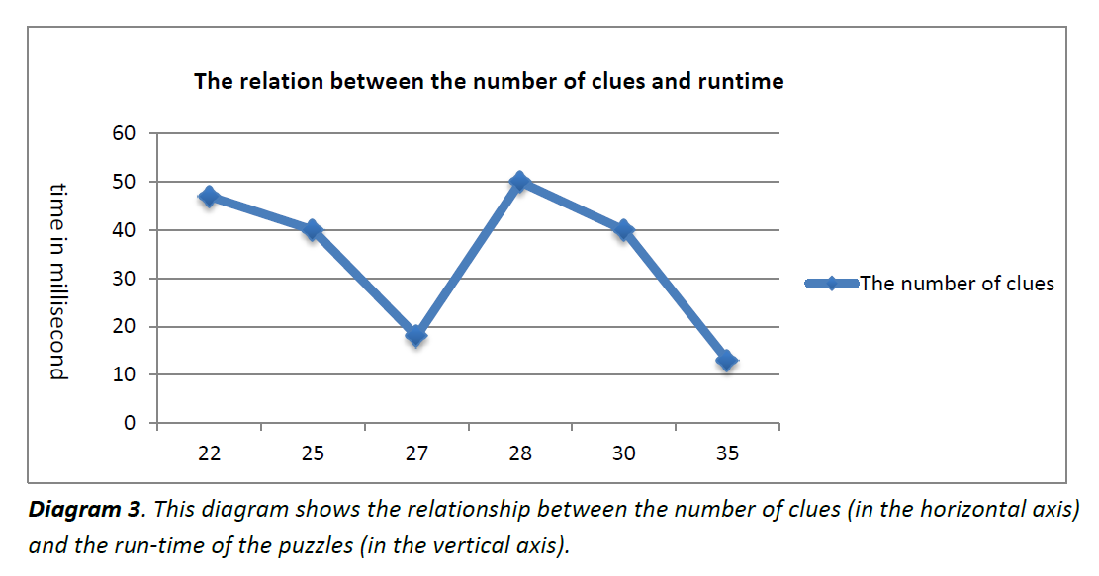
FAKE OR NOT FAKE ANSWER

Slide 19
FEATURES OF OUR PROJECT
Sudoku Generation
Easy Level
Medium Level
Hard Level
Random Level
Sudoku with required number of missing squares

Slide 20
FEATURES OF OUR PROJECT
Sudoku Solving
Solving by Backtracking Algorithm
Solving by Crook’s Algorithm
Time taken for solving

Slide 21
BACKTRACKING
Backtracking checks every possible outcome that can occur on the board and is terminated when correct output occurs in one of these outcomes.
Backtracking is Also known as “Complete Brute Force Search” OR “Depth For Search Traversal Approach in Grid”

Slide 22
BACKTRACKING ALGORITHM
In simple terms, we first start with the first empty space on the sudoku board. We add the first element that can come in that space, let’s say 1.
Next, we move on to the second empty space, and add the first element, 1, to it.
If this is valid, it will go to next space, or else the element will become 2. This repeats for every element that can be placed in that space.
This process is repeated for every empty space and if the sudoku is not solved, it goes to the first empty space and places next possible element, that is, 2, in our case.
This whole process is repeated until the sudoku is solved.

Slide 23
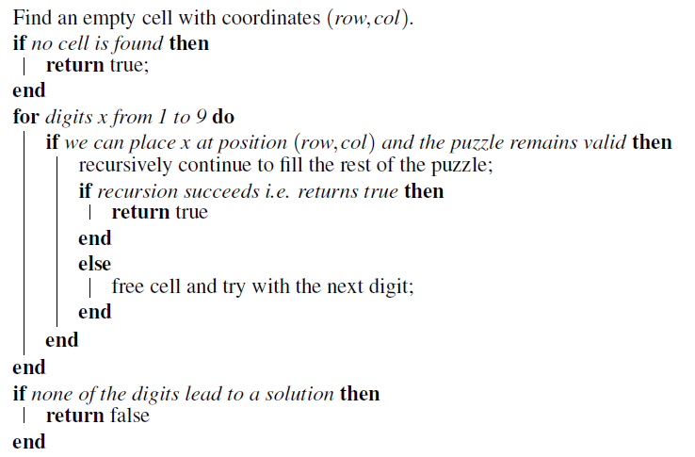
BACKTRACKING ALGORITHM

Slide 24
BACKTRACKING - ANALYSIS
The time complexity for solving the sudoku is O(n^{m}), where m = n x n, where n is the number of squares in one side of the sudoku square. In classical sudoku, n = 9. Thus, time complexity for classical sudoku is O(9⁸¹).
The recurrence relation for backtracking algorithm for classical sudoku can be written as
T(m) = 9*T(m-1) + O(1)
This is because, we have to check 9 values in a particular empty space.

Slide 25
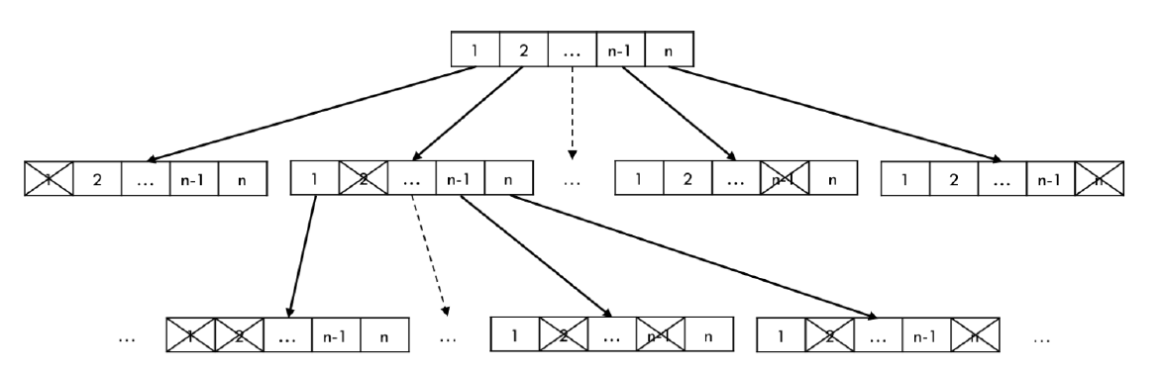
BACKTRACKING - ANALYSIS

Slide 26
BACKTRACKING - ANALYSIS
The recurrence relation can be solved using recursion tree method.
We can say that at each level of the tree time taken would be n^{k-1}c , where k is the current height of the tree and n is the number of square on one side of the sudoku board. This would mean the time complexity would be
1 + n¹ + n² + … + n^{k-1} = 1*(n^{k-1} -1)/n-1 = (1/(n-1))*n^{k}/n - (1/(n-1)) = (1/n*(n-1))*n^{k} - 1/(n-1) = O(n^{k})
Thus, the time complexity of solving a sudoku through backtracking would be O(n^{k}).

Slide 27
CROOKS ALGORITHM
Crooks algorithm, which is an imitation of pencil and paper algorithm, is a simple algorithm which we use to solve the sudoku on our own.
This algorithm sounds simple, but it has its limitations. Sometimes, we get incomplete answer to the sudoku because of multiple values that can occur on a particular empty space.

Slide 28
CROOKS ALGORITHM
(1) Find all forced numbers in the puzzle
(2) Mark up the puzzle
(3) Search iteratively for preemptive sets in all rows, columns, and boxes—taking appropriate crossout action as each new preemptive set is discovered—until
(4) either
(a) a solution is found; or
(b) a random choice must be made for continuation.
(5) If 4(a), then end; if 4(b), then go to step 3.

Slide 29
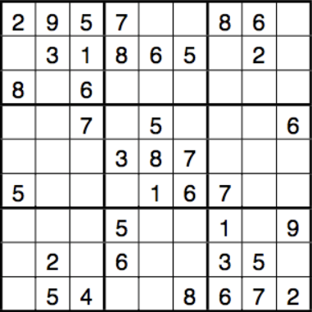
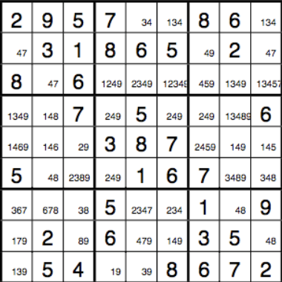
EXAMPLE

Slide 30
PSEUDO CODE [CROOKS ALGORITHM]
1 -> MARKUP
2 - > FIND SINGLETON
3 -> FIND PRE-EMPTIVE SET
4 -> ELIMINATE POSSIBLE NUMBERS OUTSIDE
PRE-EMPTIVE SET

Slide 31
LIVE DEMO
https://github.com/BhagyaRana/SUDOKU-SOLVER

Slide 32
COMPARISON
According to the data, crooks algorithm is much faster than backtracking algorithm as it eliminates the impossible outcomes and then solves the algorithm, as compared to backtracking which generates all possible sudoku matrices which takes more time.
On the other hand, complete version of Crooks algorithm is that, solve the puzzle, and if it is incomplete, complete it with backtracking.

Slide 33
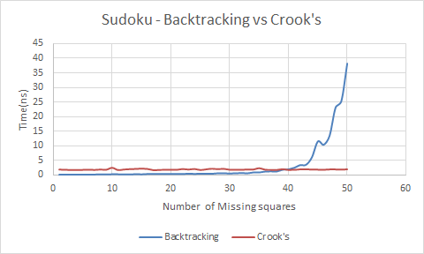
COMPARISON

Slide 34
TEST CASES FOR COMPARISON
Taking into consideration the fact that number of clues and difficulty level of a sudoku cannot be compared,
For comparative performance analysis of the two algorithms, average of the time taken by sudokus with same number of clues is taken.

Slide 35
WHICH IS BEST ALGORITHM?
Crook’s on its own is an incomplete algorithm, but it imitates solving by pencil and paper like us. It Might Get Stuck Somewhere due to Own Wrong Assumption
Backtracking checks all possible combinations but it provides correct solution. Although, it Takes More Time, But is Able to Provide Correct Answer
Best Algorithm => Backtracking Approach/ DFS Approach

Slide 36
CONCLUSION
We have Successfully Learned the Mathematical Logic Working Behind the Sudoku and How to Computationally Solve this Problem in Step-By-Step Manner.
We have also Applied the Development Knowledge to Enhance the User Experience [Instead of Running on Terminal]
We have also Successfully Understood the BackTracking Concept and Applied it in Our Project Sudoku Solver!

Slide 37
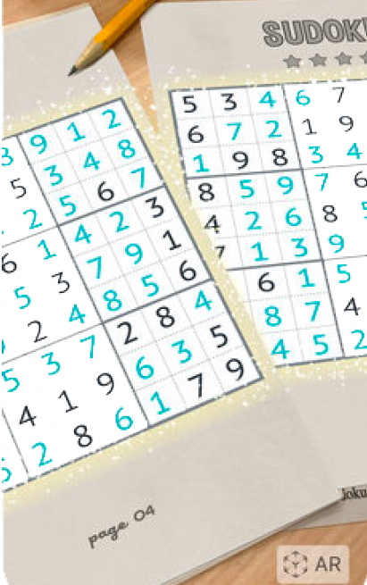
FUTURE SCOPE
(1) This Project can be Integrated with Computer Vision [AR,OpenCV & Machine Learning] to Extract Sudoku from Newspaper and Solve it in Real Time & Display on Paper.
(2) Instant Help by Giving Hints and Users Progress while Playing
(3) Score System Based on Time and Accuracy [LeaderBoard and Game Development]

Slide 38
SOURCE CODE & GITHUB REPOSITORY
Source Code Link:
https://github.com/BhagyaRana/SUDOKU-SOLVER
Individual Contribution in Github Repository :
https://github.com/BhagyaRana/SUDOKU-SOLVER/graphs/contributors

Slide 39
CONTRIBUTIONS
Sr. No. | Admission No. | Name | Contribution
1 | U19CS011 | RAJ JIKADRA | Algorithm Implementation of Sudoku Solver, Comparative Performance Analysis of Algorithm, Report Analysis
2 | U19CS012 | BHAGYA RANA | Front-End & U.I. Build, Web App Infrastructure Developer, Project P.P.T .and Report Documentation, Video Presenter

Slide 40
CONTRIBUTIONS
Sr. No. | Admission No. | Name | Contribution
3 | U19CS049 | DEV JARIWALA | Python Implementation of Algorithm, Presentation and Report Making, Video Editing
4 | U19CS080 | MUKTESHARYAN UPPALA | Backend (API Generation) for Web App, Python code for Generation of Sudoku, Algorithm Analysis, PPT and Report Proofreading, Video Presenter

Slide 41
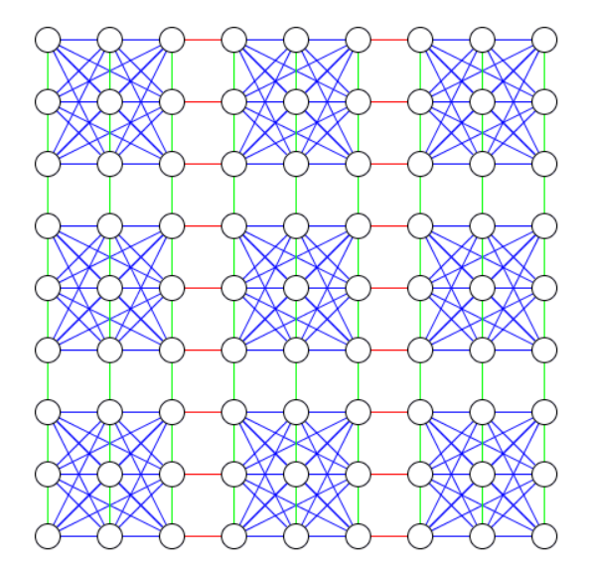
CAN SUDOKU BE SOLVED USING GRAPH COLORING?
YES/NO?
Surprisingly, The Answer is Yes!

Slide 42
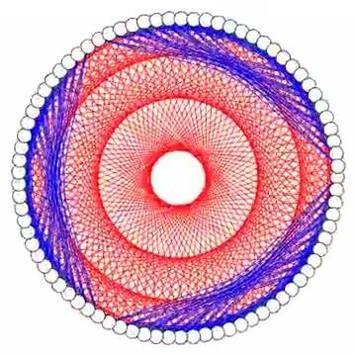

Slide 43
LET’S SOLVE IT!
Next Time, You see a Sudoku,
Think of it’s Variation, Method of Solving & Analysis of Various Approach!
The simplicity of puzzle’s structure and the low requirement of mathematical skills caused people to have enormous interest in accepting challenges to solve the puzzle
DO YOU ACCEPT THE CHALLENGE?

